Slide 1

Time series data mining
-presented by
Kavya
AP22110010408
CSE-R

Slide 2
Introduction to time series data mining
Time Series Data Mining is a vital field in data science and analytics that focuses on uncovering patterns, trends, and insights from sequential data recorded over time.Time series data is found in various fields such as finance, meteorology, healthcare, and economics. It combines traditional data mining techniques with specialized methods to handle the unique challenges of time-dependent data.It involves a range of techniques, including statistical analysis, machine learning, and deep learning, to extract meaningful patterns and make predictions based on historical data

Slide 3
Steps used in time series data mining
1.Data Collection: Gather time-dependent data from sources such as sensors, stock markets, and weather stations.
2.Preprocessing: Handle missing values, smooth the data, and make it stationary if necessary.
3.Feature Extraction: Identify trends, recurring patterns, and patterns to understand the data better.
4.Model Selection: Select an appropriate forecasting method, such as ARIMA or LSTM, based on the data and requirements
5.Training and Testing: Split data into training and testing sets to validate the model.
6.Evaluation: Measure accuracy using metrics like Mean Absolute Error (MAE).

Slide 4
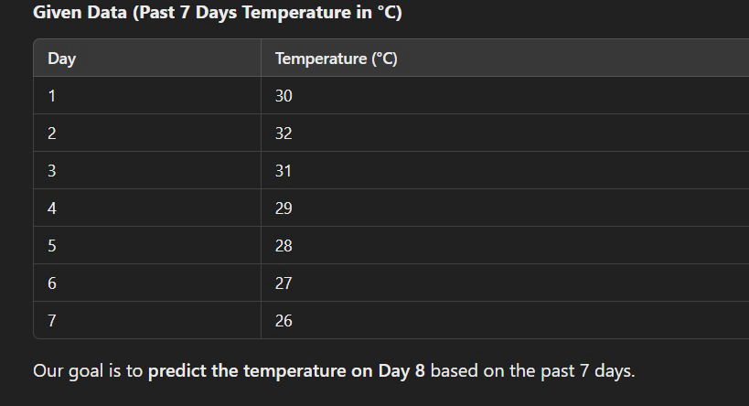
Numerical example
Time Series Forecasting of Temperature:
Let's consider a simple temperature prediction problem using time series data.

Slide 5
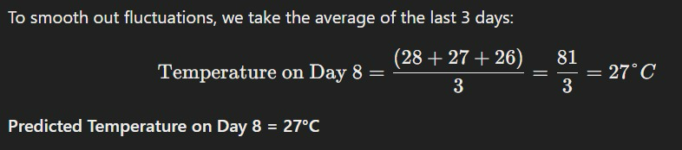
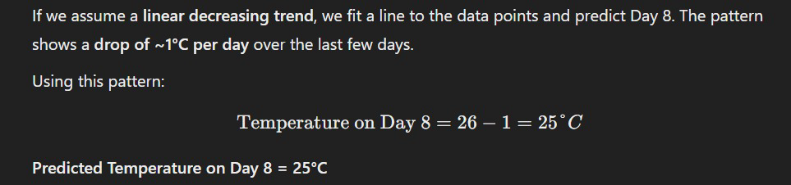
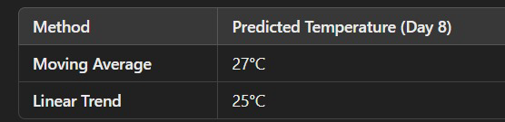
Numerical example
Method 1
Method 2
Moving Average Method(3-day moving average)
Simple Linear Regression Approach
Final answer :

Slide 6
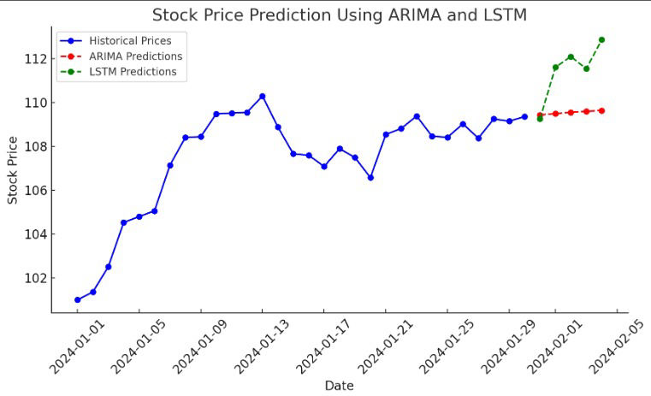
Applications of time series data mining
Finance : stock prices prediction
Stock market movements are influenced by various factors like economic conditions, news, and investor behavior. ARIMA models help in analyzing historical price trends and making short-term predictions based on statistical patterns. Meanwhile, LSTM models, being deep learning-based, can capture nonlinear dependencies and learn from vast amounts of past data to predict stock prices more accurately. By combining these approaches, analysts can improve forecasting accuracy and make better investment decisions.

Slide 7
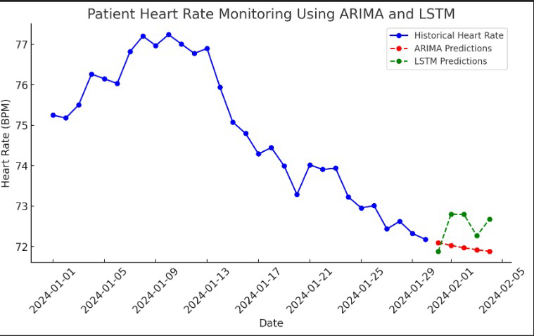
Health care : patient monitoring
In healthcare, time series data mining plays a crucial role in patient monitoring. Hospitals collect real-time data from sensors, such as heart rate, blood pressure, and oxygen levels, to track patient health over time. ARIMA can help identify trends in vital signs and detect abnormalities, while LSTM models can predict potential health risks by analyzing past patterns. This helps doctors take early action, improving patient care.

Slide 8
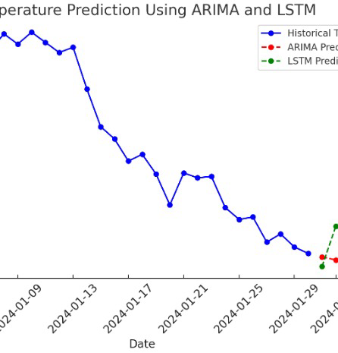
Weather forecasting:rainfall and temperature prediction
Time series data mining is widely used in weather forecasting to predict rainfall and temperature based on historical patterns. ARIMA models help identify trends in past weather data, such as temperature fluctuations or seasonal rainfall variations. Meanwhile, LSTM models analyze long-term dependencies and capture complex patterns in climate changes. By combining these models, meteorologists can make accurate weather predictions, which help in disaster management and agricultural planning.

Slide 9
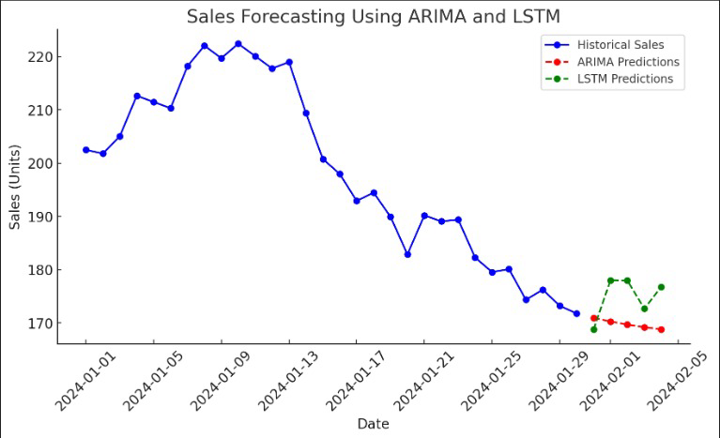
Business analytics : sales forecasting
Sales forecasting is a key application of time series data mining, helping businesses predict future sales based on historical data. ARIMA models analyze past sales trends and seasonality to generate short-term forecasts, while LSTM models learn complex patterns and long-term dependencies to provide more accurate predictions. By using these models, businesses can optimize inventory, plan marketing strategies, and improve financial planning.

Slide 10
Advantages
1. Helps in forecasting and decision making
2. Detects trends and seasonal patterns
3.applicable in various fields
1. Data cleaning is time consuming
2. Sensitive to noise and errors
3. requires complex transformation for data change patterns
Disadvantages

Slide 11
Conclusion:
Time series data mining helps us analyze past trends to make better future predictions. It is widely used across various industries and continues to evolve with new technologies. Mastering time series analysis can lead to better decision-making and improved accuracy in forecasting. With advancements in AI and machine learning, time series forecasting is becoming more precise and impactful, making it an essential tool for businesses, healthcare, and environmental studies.

